Slide 1
- Add counter arguments - Do sources

Slide 2
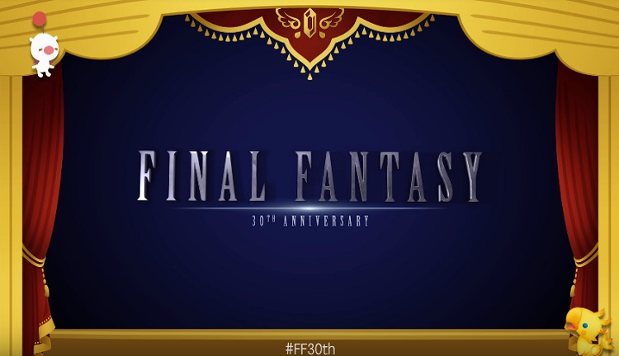
Make
Great Again

Slide 3
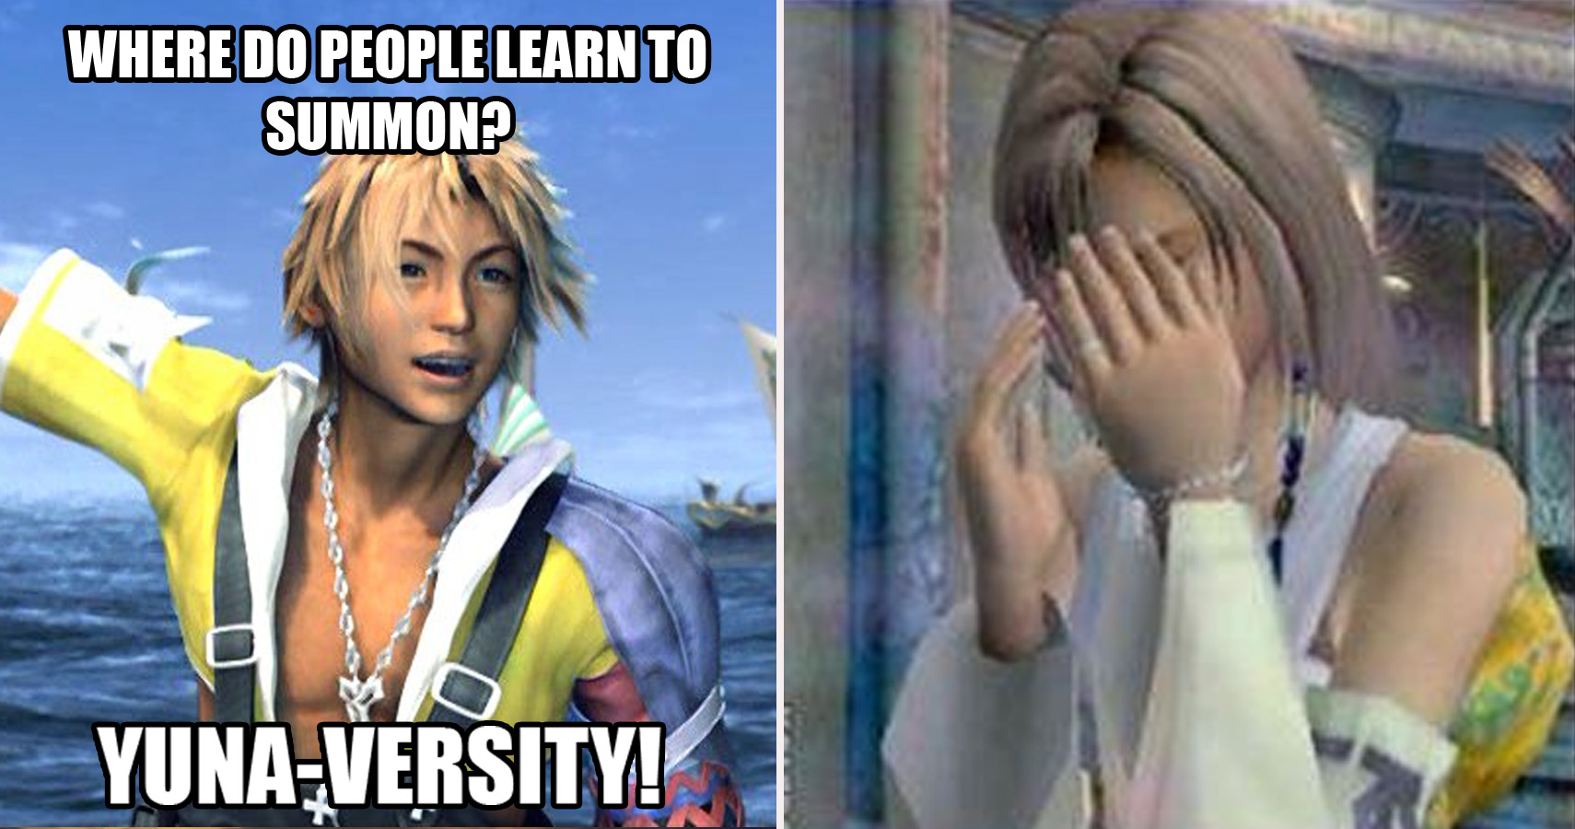
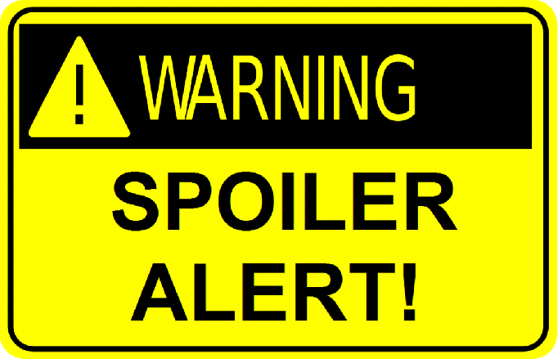
Spoiler Alert

Slide 4
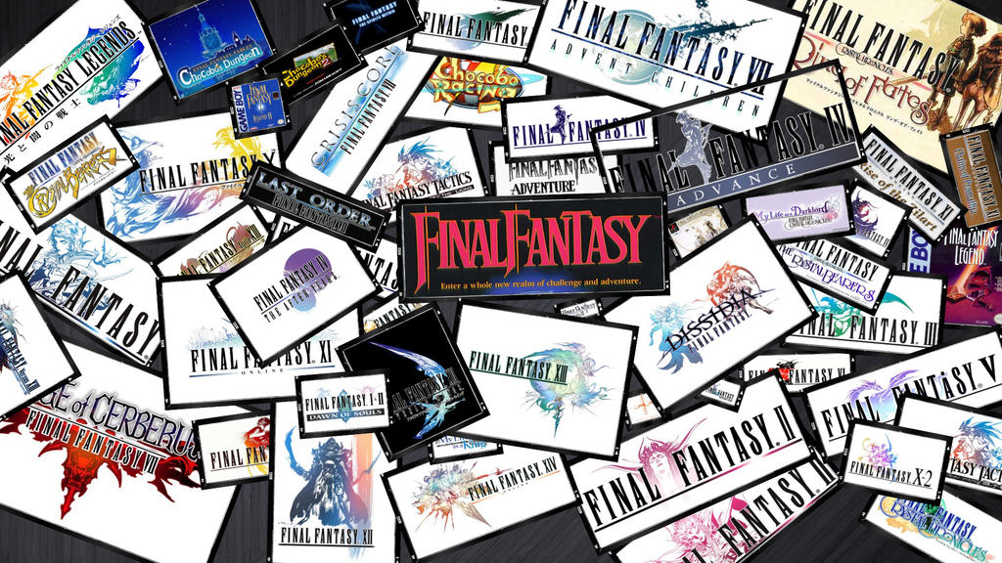
What is Final Fantasy?
Final Fantasy is an ongoing series of JRPG’s.
Although they all share the Final Fantasy name, each game in the main series is it’s own individual game.
The games have many common elements (enemies, items, mechanics, etc.)
Not narratively linked.
The series celebrated it’s 30th anniversary in 2017.

Slide 5
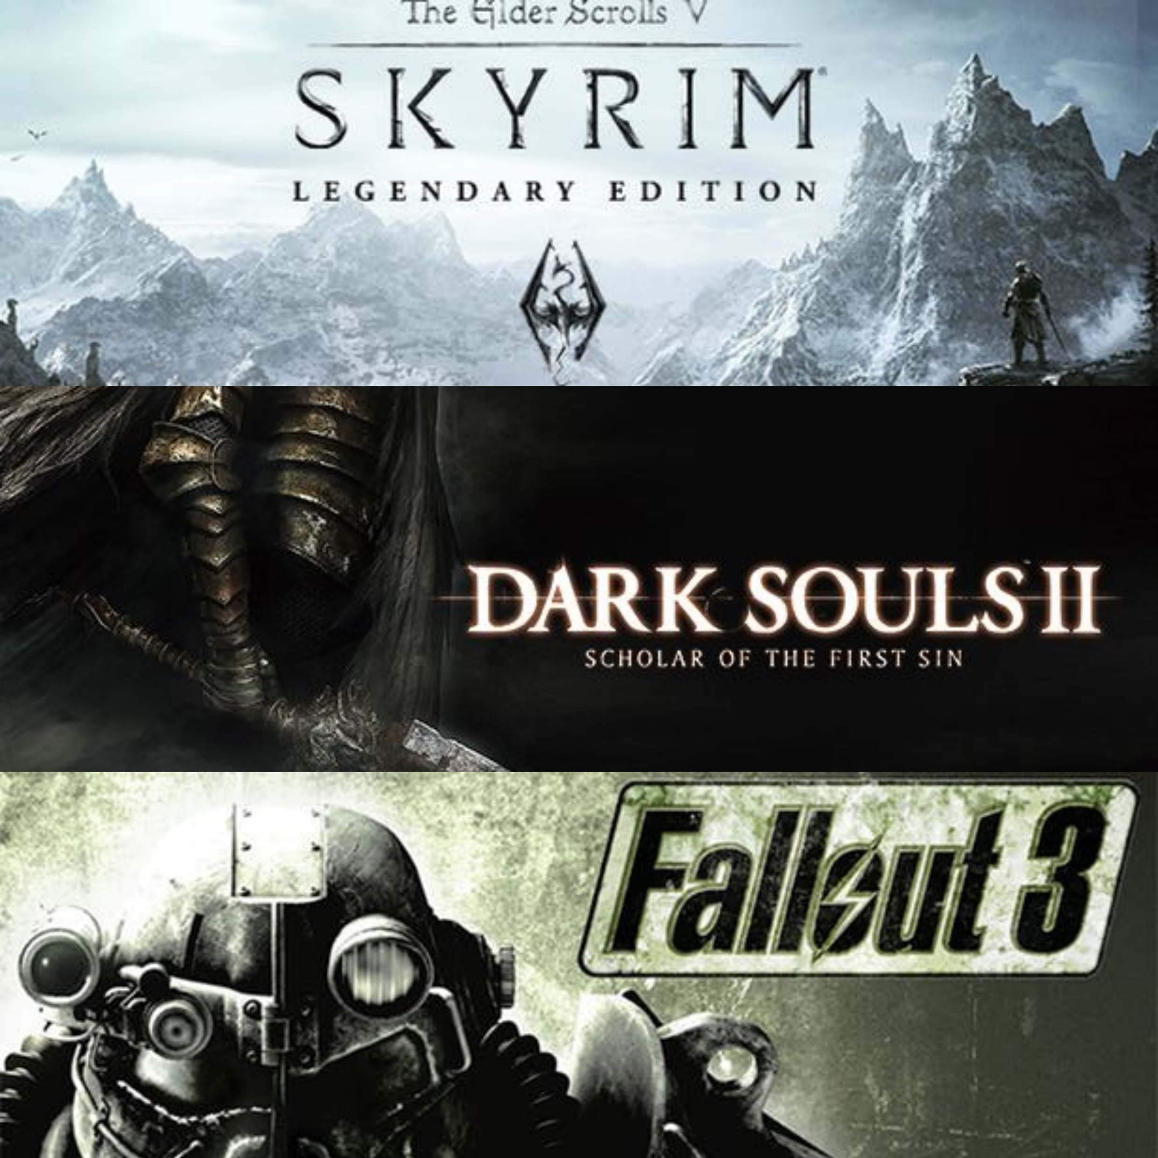
WRPG
Western RPG’s
You are the story and the story builds around you as you play.
Skyrim -
Dark Souls -
Fallout 3 -
are a few examples.

Slide 6
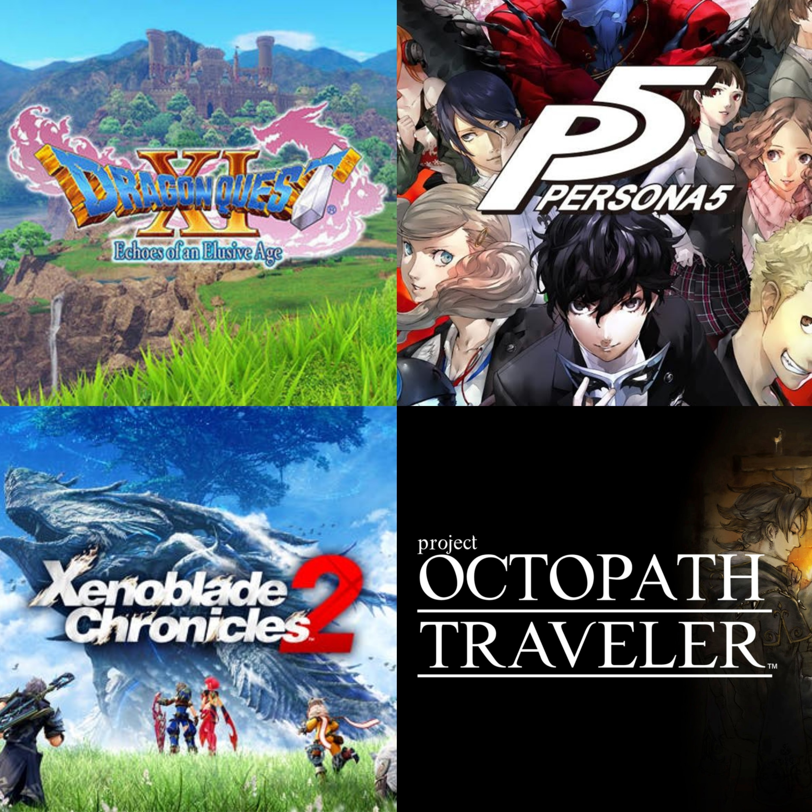
JRPG’s
You’re interacting in someone else’s story and are just along for the ride.
A few of the more popular ones are…
Dragon Quest XI
Persona 5
Xenoblade Chronicles 2
Octopath Traveler

Slide 7
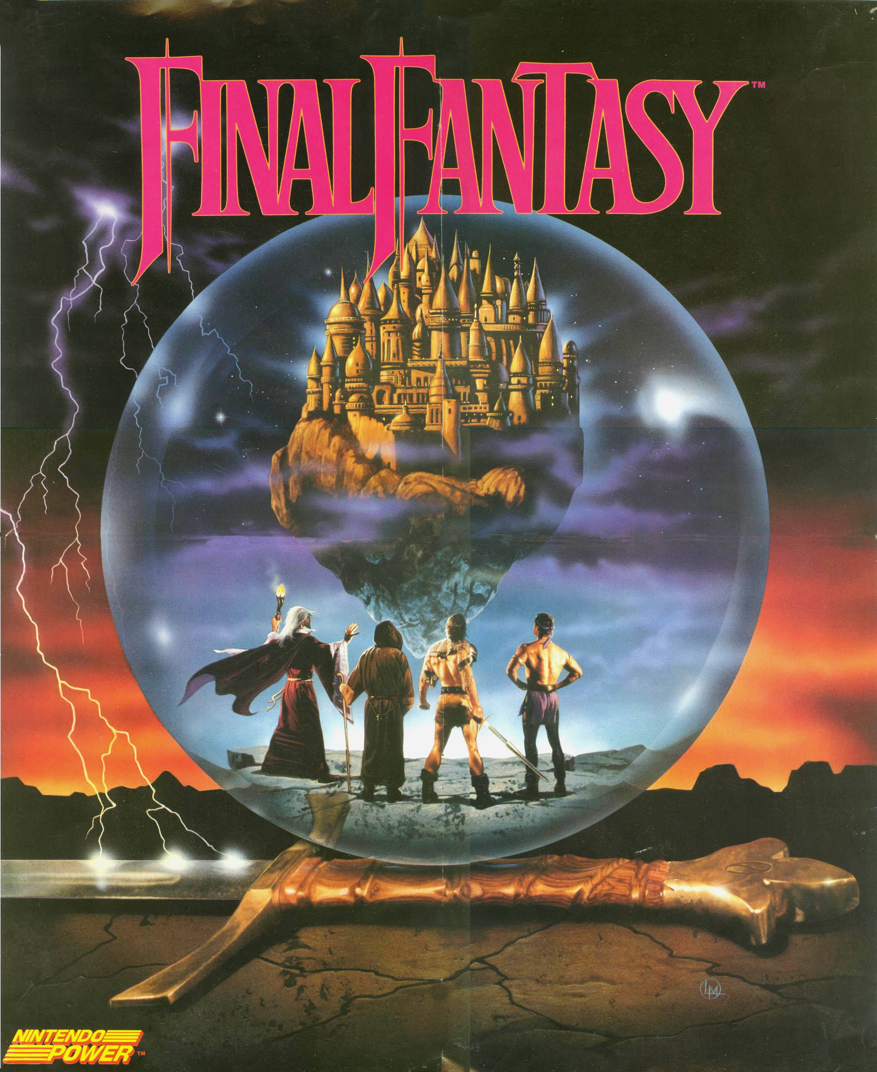
Early Final Fantasy
Final Fantasy 1 was originally released in 1987 on the NES.
This is the original Final Fantasy on the cover of Nintendo power!

Slide 8
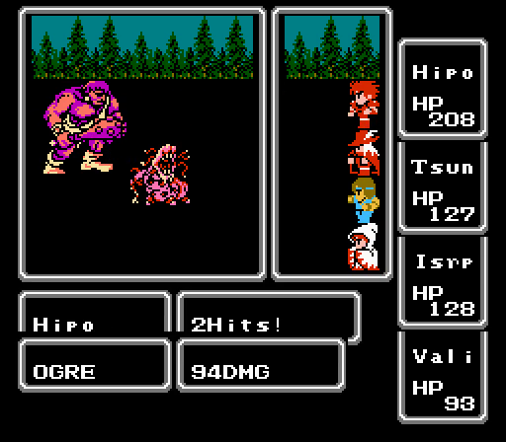
D&D Influence
This player chose a fighter, bard, monk and white mage. Nice!
Like many RPG’s of the era, Final Fantasy was heavily influenced by Dungeons and Dragons the tabletop game.
Much like in D&D you could pick your party members jobs before heading out.
Here you play as the four warriors of light in an attempt to save the crystals!

Slide 9
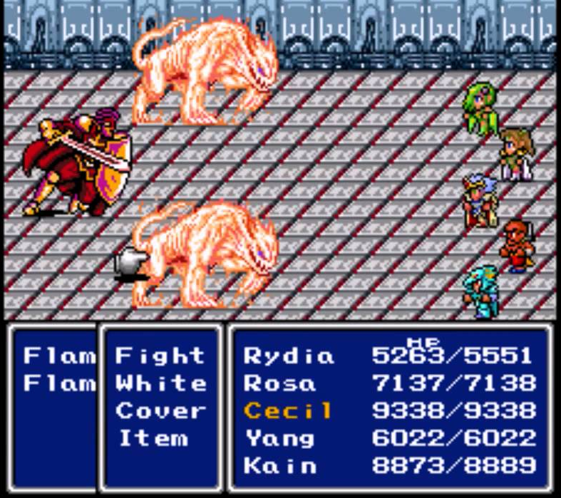
Final Fantasy Golden Era - FFIV
By xxxx Final Fantasy was starting to pick up a big following in the U.S. Although the numbering gets a little tricky from here on out, this was released in the states as Final Fantasy 2 on the SNES.
This was also my first Final Fantasy game. I hadn’t ever experienced a game like it before.
You level up and get stronger just playing? Awesome!
There’s an interesting story line and well developed characters? No way!
Hidden treasure off the beaten path and a spoony bard to boot? NERDGASM!
This is one of the rare times when Kain isn’t backstabbing the party…

Slide 10
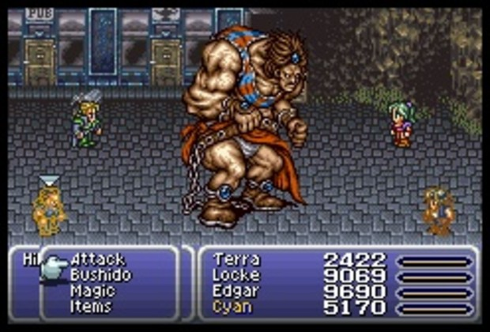
Final Fantasy Golden Era - FFVI

Slide 11
What Happened

Slide 12
What can be done?

Slide 13
Game Design
Narrative
- has consequences
Gameplay
Good character development for power fantasy
Thoughtful combat
Setting
Management

Slide 14
Narrative
Feels like it has consequences, impactful
Easy to understand, lore to find

Slide 15
What Happened?

Slide 16
Graphical Focus

Slide 17
Spirits Within

Slide 18
Square’s Financial Troubles

Slide 19
Enix desire to reach western audience

Slide 20
Square-Enix Merger

Slide 21
Outcome

Slide 22
How do you ruin ice cream?

Slide 23
Multiplayer Focus

Slide 24
FFXI

Slide 25
FFXIV

Slide 26
Graphical Focus

Slide 27
Costs

Slide 28
Asset Reuse

Slide 29
Off shoots

Slide 30
Development Time

Slide 31
Attempts to westernize

Slide 32
Combat Changes

Slide 33
Automation

Slide 34
Action over strategy

Slide 35
Streamlining

Slide 36
Character Progression

Slide 37
Job System (1, 5, 11, 14)

Slide 38
Sphere Grid (FFX)

Slide 39
License Board (FFXII)

Slide 40
Crystal Pathway (FFXIII)

Slide 41
(FFXV)

Slide 42
Equipment

Slide 43
FF9 eq

Slide 44
FF13/FF15

Slide 45
FF6

Slide 46
FF9

Slide 47
FF10

Slide 48
Ffx13 bad char

Slide 49
Bad char in 15
Jobandrogny

Slide 50
Summons loss of identity

Slide 51
Big awesome specftaclses

Slide 52
FFXII
All regular summons are now the names of airships?
New summons plod around behind you?

Slide 53
FFXV
Summons now can’t even be summoned, they just appear sometimes.

Slide 54
Narrative Trouble

Slide 55
Stories aren’t confined to a single game

Slide 56
Incoherent stories

Slide 57
Forgettable characters

Slide 58
No well defined villain

Slide 59
Problem of capitalism

Slide 60
Graphics =/ profit

Slide 61
Demand for AAA low graphic rpgs

Slide 62
Memories
FF4 – Red Wings
FF6 – Opera Scene
FF7 – Sephiroth in flames
Meteor
Weapons
Aeris
FFX – Sin destroys zanarkand
Sin destroys kilika
Tidus and Yuna
What part did graphics play in that feeling?

Slide 63
Stop Westernizing
FF Fans don’t want Westernized games.
Button mashers and games that require no thought aren’t fun.
Turned based combat isn’t dead.
Octopath showed there’s a lot of innovation that got left behind.

Slide 64
Player driven progression
Bring back jobs or multi char pre defined roles.
Leveling and customizing your characters strengths is fun.
Equipment is integral to this process.

Slide 65
Characters
Stop sanitizing them for the western audience.
Contain their character arc to the game.
The antagonist is usually the most interesting character in the game so…
Make a giant monster(Sin(FFX), weapons(FFVII))
Relateable, ultra powerful person (Sephiroth(FVII),Kuja(FFIX)),
Totally insane (Kefka(FFVI)

Slide 69
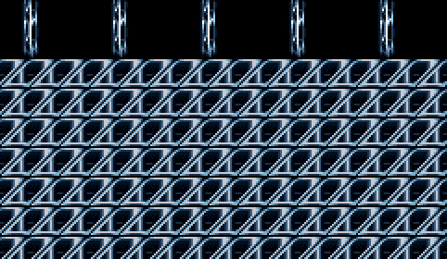
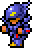
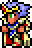
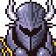
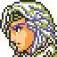

Slide 70
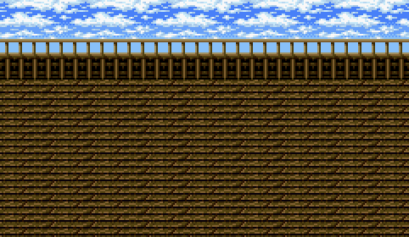
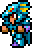
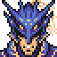
Cain

Slide 71
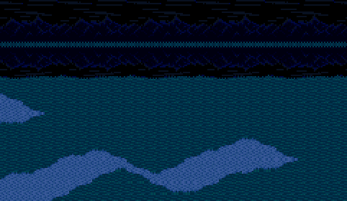
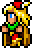
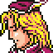
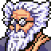

Tellah
Tellah attacks Golbez and casts spells on him, but finds they have no effect. He then converts his own life energy into the necessary magic power to cast Meteor, which severely wounds Golbez
Everyone surrounds Tellah, who is dying due to casting Meteor at the cost of his own life. He asks the others to avenge Anna for him, and dies.

Slide 72
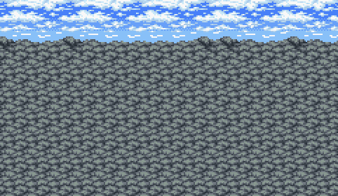
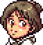
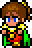

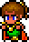
Palom and Porem
After defeating him, Cagnazzo has one last trick up his sleeve. When the party tries to escape, the walls cave in. Palom and Porom save Cecil's party by petrifying themselves. Tellah tries to heal them, but to no avail, as they have turned into stone of their own will. This act of sacrifice further strengthens the party's resolve to stop Golbez.

Slide 73
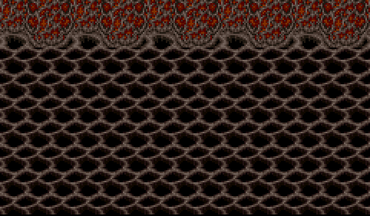



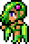
Rydia

Slide 74
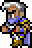
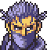
Edge
Edge is rude, hotheaded and stubborn, refusing to give up his pursuit of Rubicante and not backing down from the fight despite being outmatched. He is mean and obnoxious to the party at first, but comes to appreciate their help over time. He has an unrequited crush on Rydia and flirts with other women occasionally, remarking that Rydia and Rosa make "two babes in the party". He has a short temper and uses his rage as a source of power in his rematch with Rubicante, unlocking new Ninjutsu skills.

Slide 76
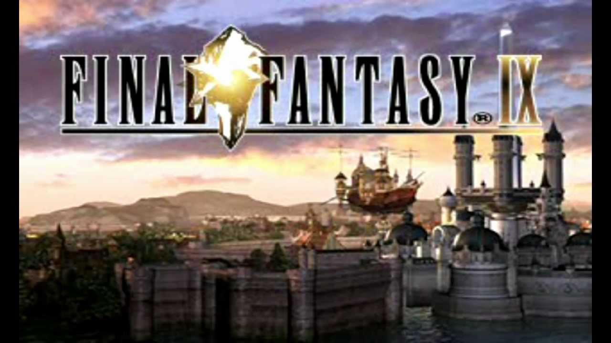
ff9
Every story on it’s own is sad, but when combined together make a beautiful story

Slide 77
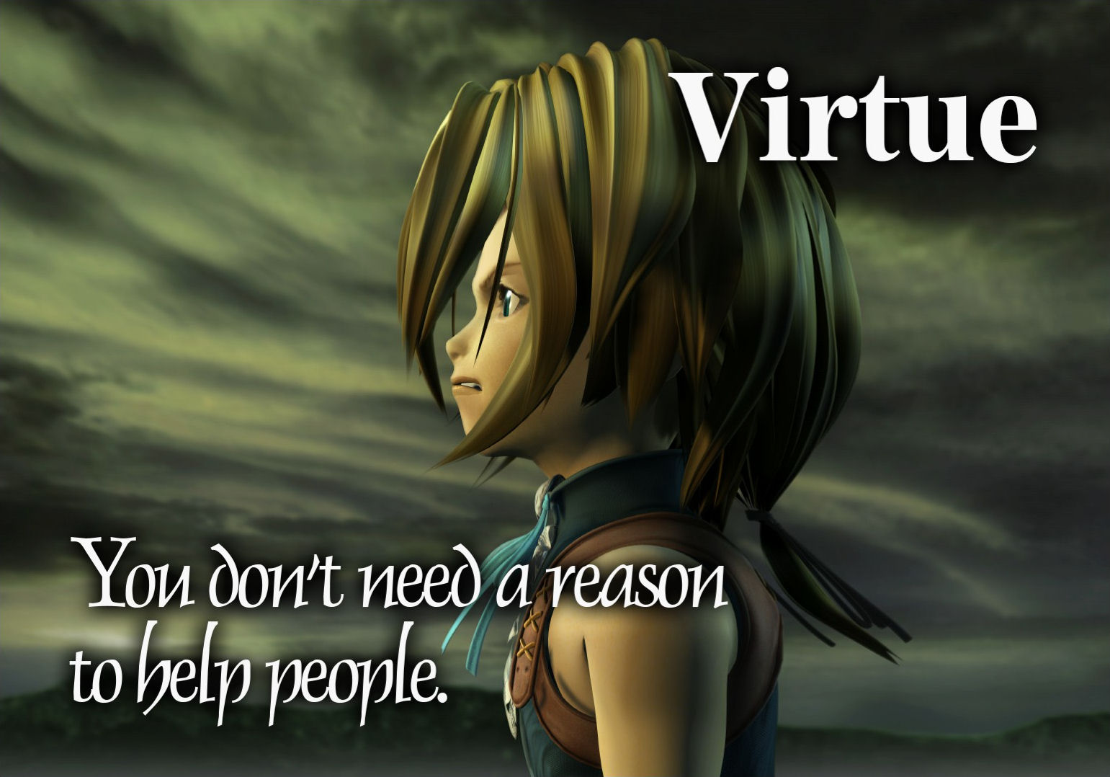

Slide 78
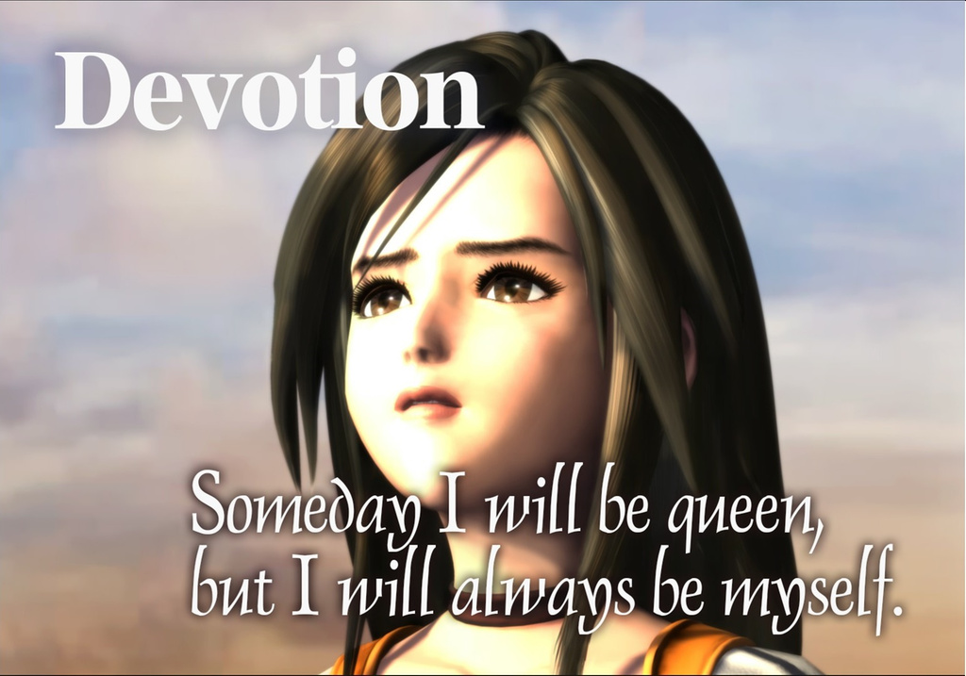

Slide 79
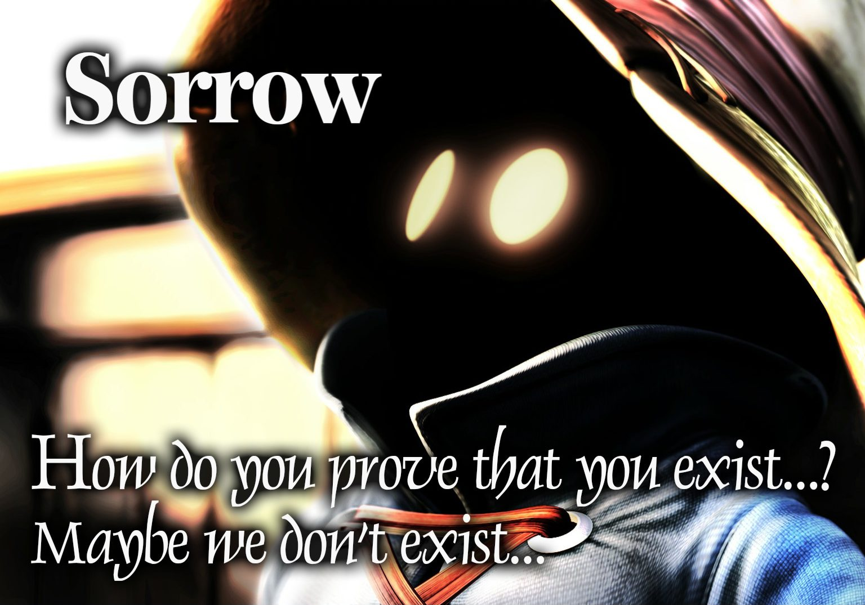

Slide 80
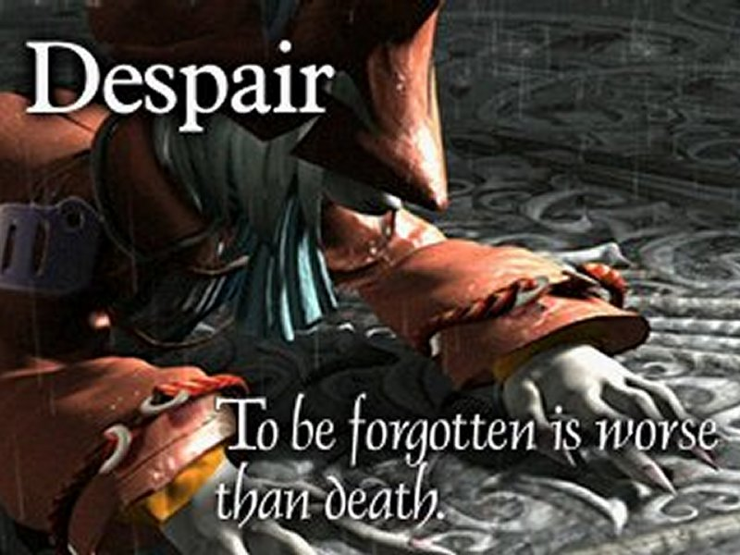

Slide 81
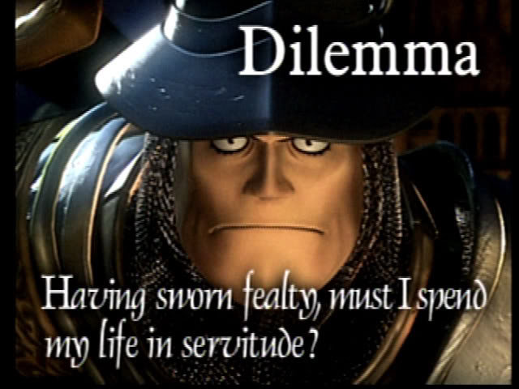

Slide 82
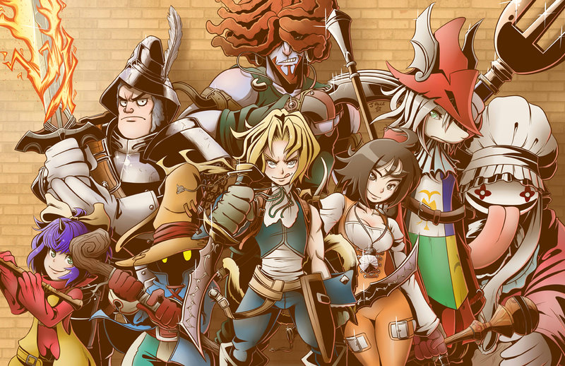

Slide 83
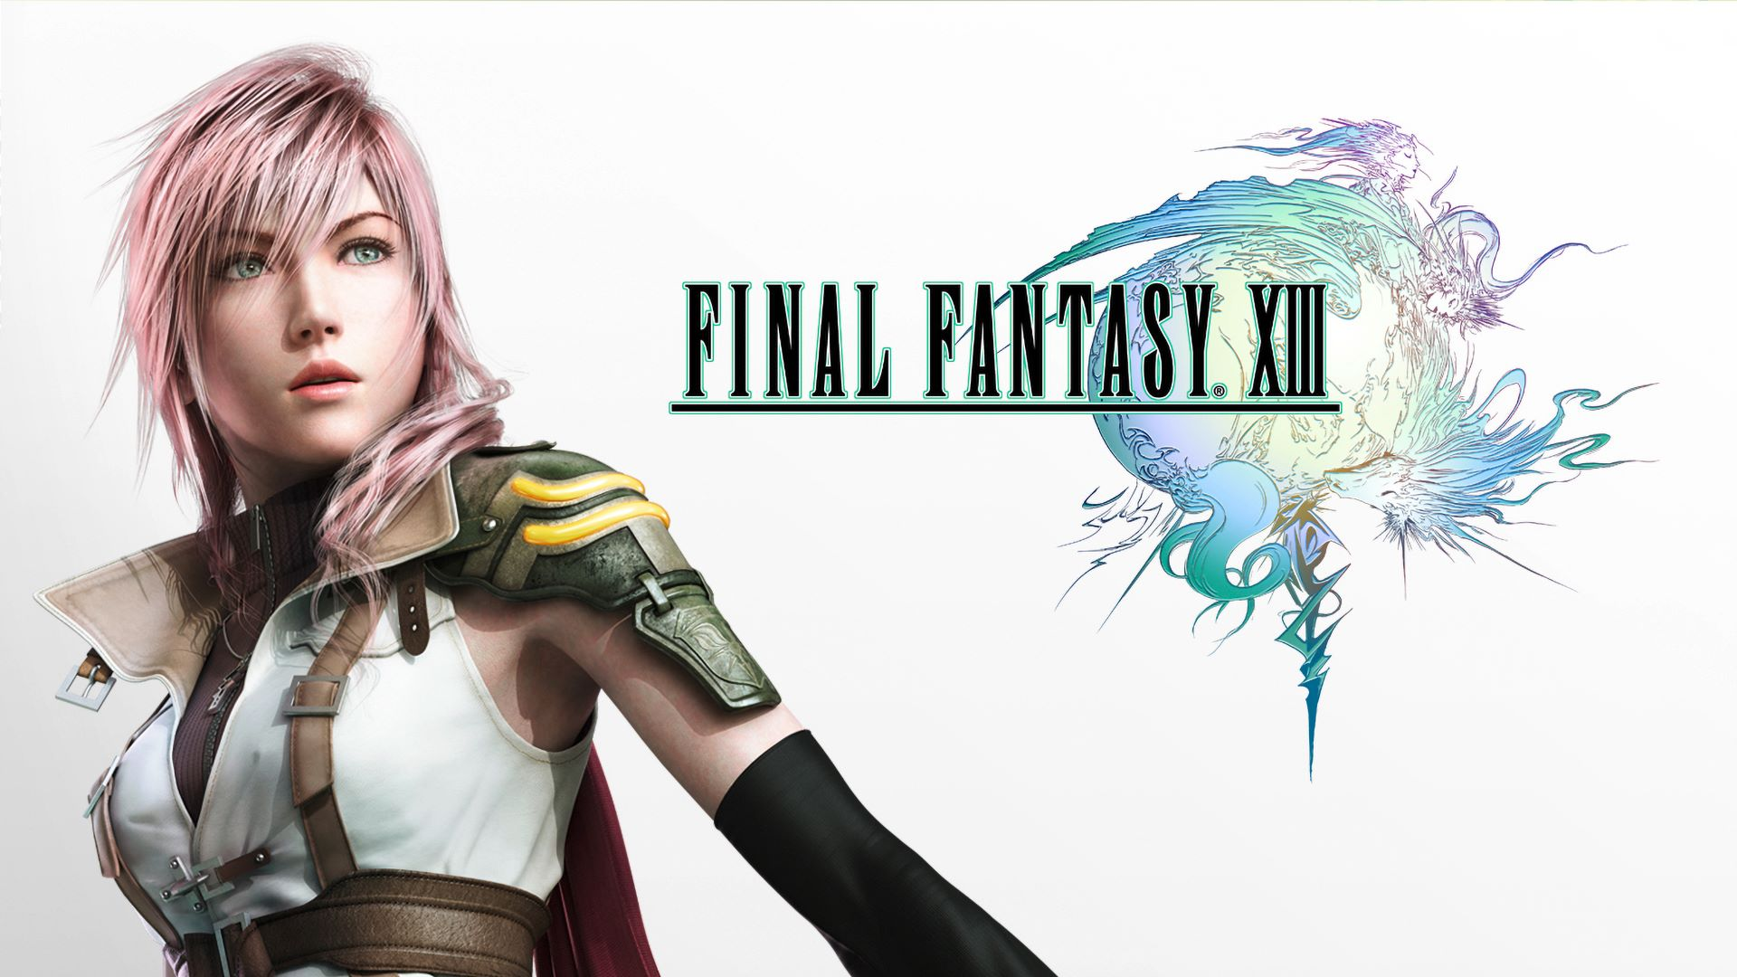
Lightning
You’d probably think that the girl on the cover of the box was supposed to be the main character, but ‘Lightning’ (a name which really just rolls off the tongue) has probably the least amount of personality or influence on the story of anyone.
Notes:
https://venturebeat.com/2011/05/13/why-final-fantasy-xiii-is-a-terrible-game/

Slide 84
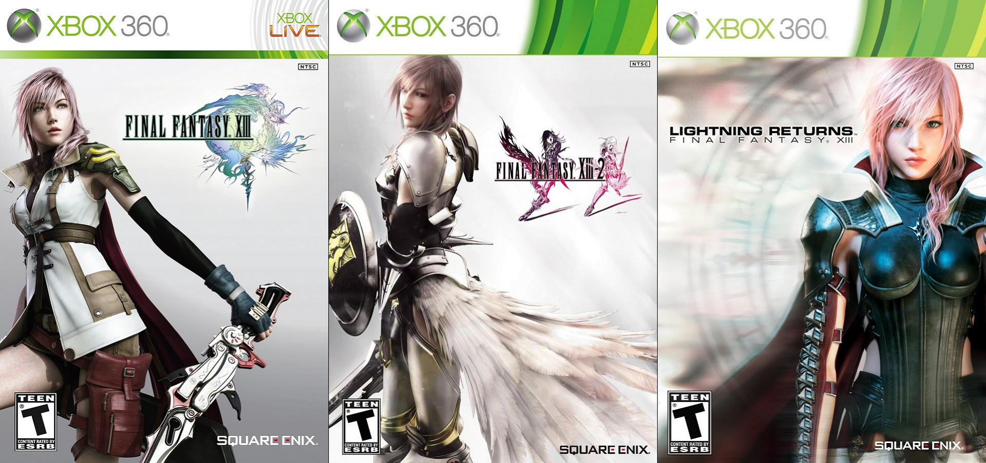

Slide 85
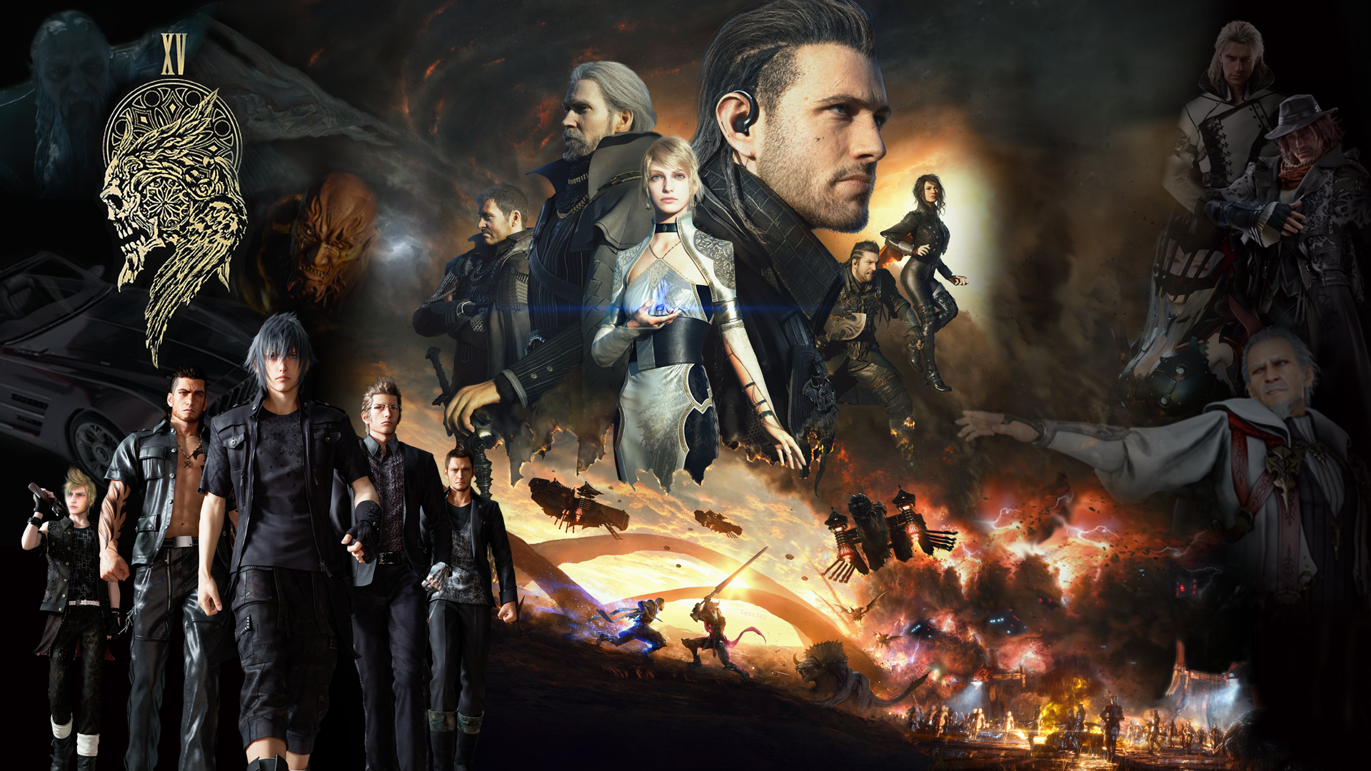
Notes:
https://www.deviantart.com/realzeles/art/Final-Fantasy-XV-universe-Wallpaper-1080p-620627951

Slide 86
Ffx good story
Intersting blelievable villains/monsters
Moral choices (marriage/duty)
World constantly feels like it’s about o end

